Slide 1
While waiting ...
Set up an account at www.qwiklabs.com
Wifi: GoogleGuest

Slide 2
Big Data, AI, ML

Slide 3
Welcome

Slide 4
Self Intro

Slide 5
What did you sign up for?

Slide 6
A community-run study group for developers.

Slide 7
A chance to learn a specific skill you can use for personal development or career advancement.

Slide 8
Or just for fun :-)

Slide 9
Want this preso?

Slide 10
Want this preso?
http://bit.ly/get-this-preso

Slide 11
Want this preso?
http://bit.ly/get-this-preso

Slide 12
Does everyone know
Google Cloud Platform?

Slide 13
Agenda
6:30 pm | Welcome!
6:35 pm | Get free access to Qwiklabs
6:40 pm | Google Cloud Platform Essentials labs
7:30 pm | Break
7:45 pm | Data, ML, AI Labs Lab 3: CloudML Engine Qwik Start
9:00 pm | Event ends … but you can continue at home

Slide 14
Important Notes
If you already have a QwikLabs account, sign out before using the link in order to ensure you get the credits
Always use INCOGNITO MODE

Slide 15
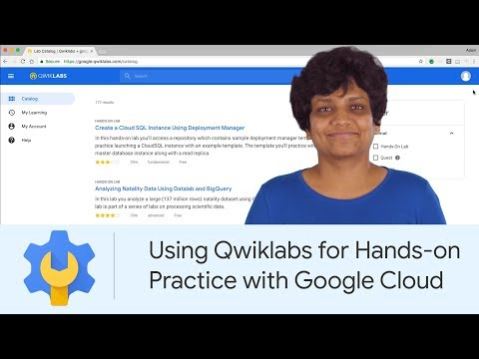
Introduction to QwikLabs

Slide 16
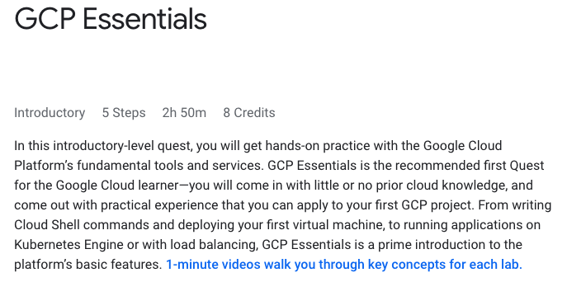
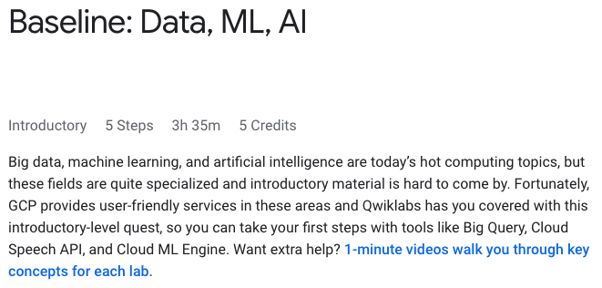
Which Quest first?
New to Google Cloud Platform
Already know Google Cloud Platform
https://google.qwiklabs.com/quests/23
https://www.qwiklabs.com/quests/34

Slide 17
Which Quest first?
New to Google Cloud Platform
A Tour of Qwiklabs and the Google Cloud Platform
Creating a Virtual Machine or Compute Engine: Qwik Start - Windows
Getting Started with Cloud Shell & gcloud
Kubernetes Engine: Qwik Start
Set Up Network and HTTP Load Balancers
https://google.qwiklabs.com/quests/23

Slide 18
Which Quest first?
New to Google Cloud Platform
A Tour of Qwiklabs and the Google Cloud Platform
Creating a Virtual Machine or Compute Engine: Qwik Start - Windows
Getting Started with Cloud Shell & gcloud
Kubernetes Engine: Qwik Start
Set Up Network and HTTP Load Balancers
https://google.qwiklabs.com/quests/23

Slide 19
Which Quest first?
Already know Google Cloud Platform
Cloud ML Engine: Qwik Start
Dataprep: Qwik Start
Dataflow: Qwik Start - Templates or
Dataflow: Qwik Start - Python
Dataproc: Qwik Start - Console or
Dataproc: Qwik Start - Command Line
Cloud Natural Language API: Qwik Start or
Google Cloud Speech API: Qwik Start or
Video Intelligence: Qwik Start
https://www.qwiklabs.com/quests/34

Slide 20
Which Quest first?
Already know Google Cloud Platform
Cloud ML Engine: Qwik Start
Dataprep: Qwik Start
Dataflow: Qwik Start - Templates or
Dataflow: Qwik Start - Python
Dataproc: Qwik Start - Console or
Dataproc: Qwik Start - Command Line
Cloud Natural Language API: Qwik Start or
Google Cloud Speech API: Qwik Start or
Video Intelligence: Qwik Start
https://www.qwiklabs.com/quests/34

Slide 21
Demo

Slide 22
Let’s get started

Slide 23
Please use Incognito Mode

Slide 24
Please use Incognito Mode
… it will make your life much easier

Slide 25
Please use Incognito Mode
… it will make your life much easier
Trust me :-)

Slide 26
Let’s get started
Step 1: Go into Incognito Mode & sign out of your Qwiklabs account
Step 2: Go to https://go.qwiklabs.com/cloud-study-jams-2019
and click “Enroll” on Baseline: Data, ML, AI
Step 3: Enter the Study Jam Access Code 1s-singapore-2794
Step 4: Sign into your account

Slide 27
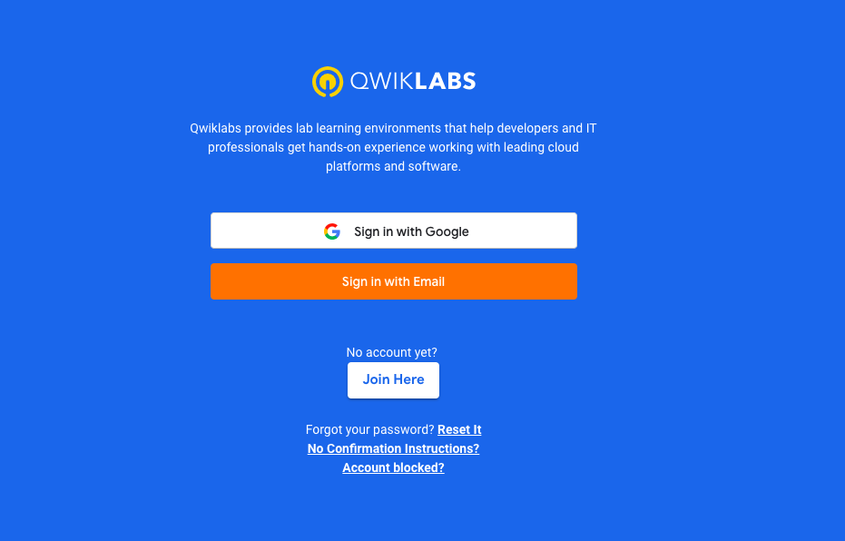
Step 1: Go into Incognito Mode & sign out of your Qwiklabs account

Slide 28
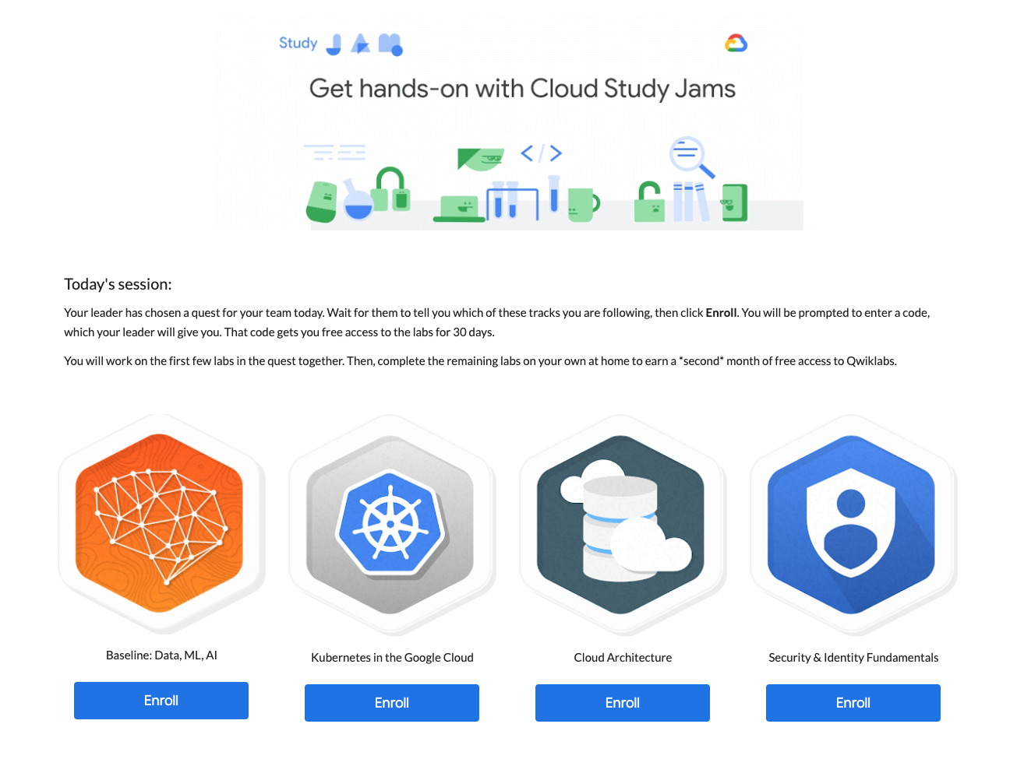
Step 2: Go to
https://go.qwiklabs.com/cloud-study-jams-2019
and click “Enroll” on
Baseline: Data, ML, AI

Slide 29
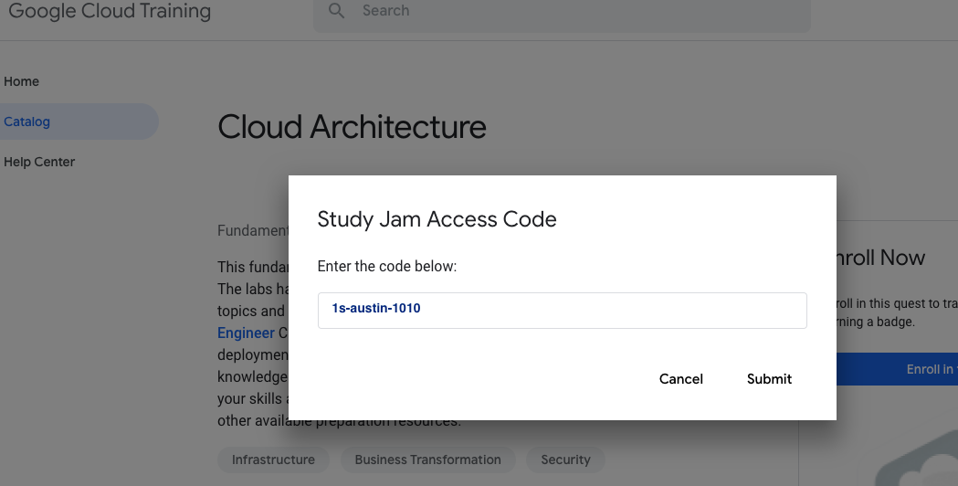
Step 3:
Enter the Study Jam Access Code
1s-singapore-2794

Slide 30
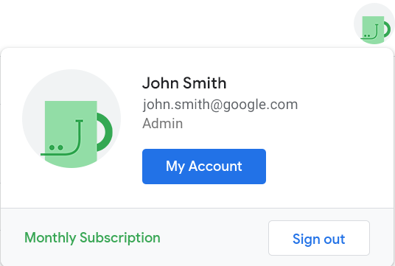
Step 4: Sign into your account
Sign in with your Google account or email
Hover over avatar on top right and make sure it says “monthly subscription”.

Slide 31
Let’s get started
Step 1: Go into Incognito Mode & sign out of your Qwiklabs account
Step 2: Go to https://go.qwiklabs.com/cloud-study-jams-2019
and click “Enroll” on Baseline: Data, ML, AI
Step 3: Enter the Study Jam Access Code 1s-singapore-2794
Step 4: Sign into your account & go to
https://google.qwiklabs.com/quests/23

Slide 32
Which Quest first?
New to Google Cloud Platform
Already know Google Cloud Platform
https://google.qwiklabs.com/quests/23
https://www.qwiklabs.com/quests/34

Slide 33
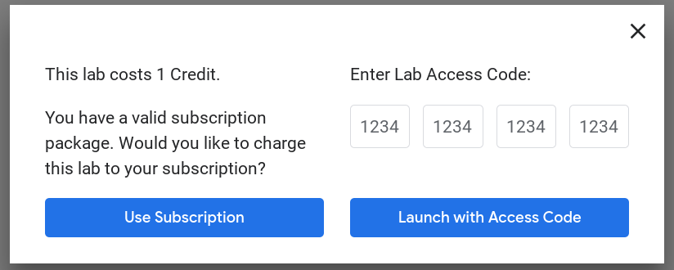
Having trouble?
Sign out of your Qwiklabs account and sign back in.
Note that you will still see prices on labs - but you will be able to use your subscription to take them. When you are prompted for payment, simply click “Use Subscription” to take the lab with your free 1-month pass.
Still having trouble? Reach out to Support@Qwiklabs.com and we’ll be happy to assist!

Slide 34

Break
Wow, you have done a lot in the Cloud in a short amount of time! You’ve earned a break.
Share with fellow attendees what you found hard or easy in the labs so far.

Slide 35
Which Quest first?
New to Google Cloud Platform
Already know Google Cloud Platform
https://google.qwiklabs.com/quests/23
https://www.qwiklabs.com/quests/34

Slide 36
Wrap Up

Slide 37
Remember:
You have a month of free Qwiklabs use (Today’s code can only be activated today)
Finish the Quest to earn a badge and get another month of free access
Qwiklabs is at www.qwiklabs.com
Post any thoughts or feedback using #CloudStudyJam to @CloudAceSG

Slide 38
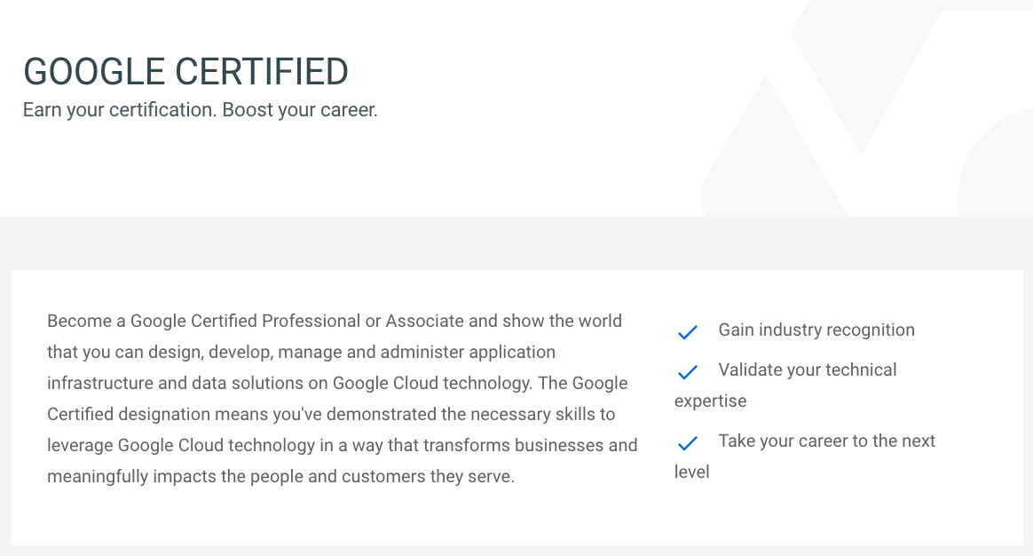
Google Certification
Have you completed the labs? You’re now in a great position to take your career to the next level.
Go to cloud.google.com/certification and find out how you can become a Google Certified Professional.

Slide 39
Two more things ...

Slide 40
Signing up for GCP … 3 options
Free Trial
Partner Credit
Partner Contract
$300
Requires credit card
Instant sign-up
$500 credit
Requires credit card
2-3 days approval
$500 credit
Requires agreement (no credit card)
2-3 days
Additional partner support from Cloud Ace
https://cloud.google.com/
http://bit.ly/500please
andrew@cloud-ace.com

Slide 41
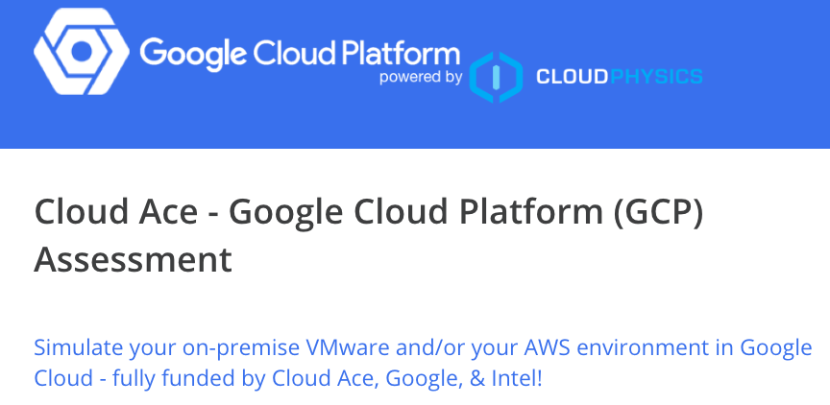
Assessing your current VM environment
http://bit.ly/vmassess

Slide 42
Thank you ...

Slide 43
Thank you …
and good luck with the study!

